Slide 1



Slide 2

Republique Algerienne Democratique et Populaire
Universite des Sciences et de Ia Technologie Houari Boumediene
REVOLUTIONIZING CONNECTIVITY
An In-Depth Exploration of Information and Communication Technologies (TIC)
FACULTE D'INFORMATIQUE
L1 ING INFORMATIQUE SECTION C

Slide 3

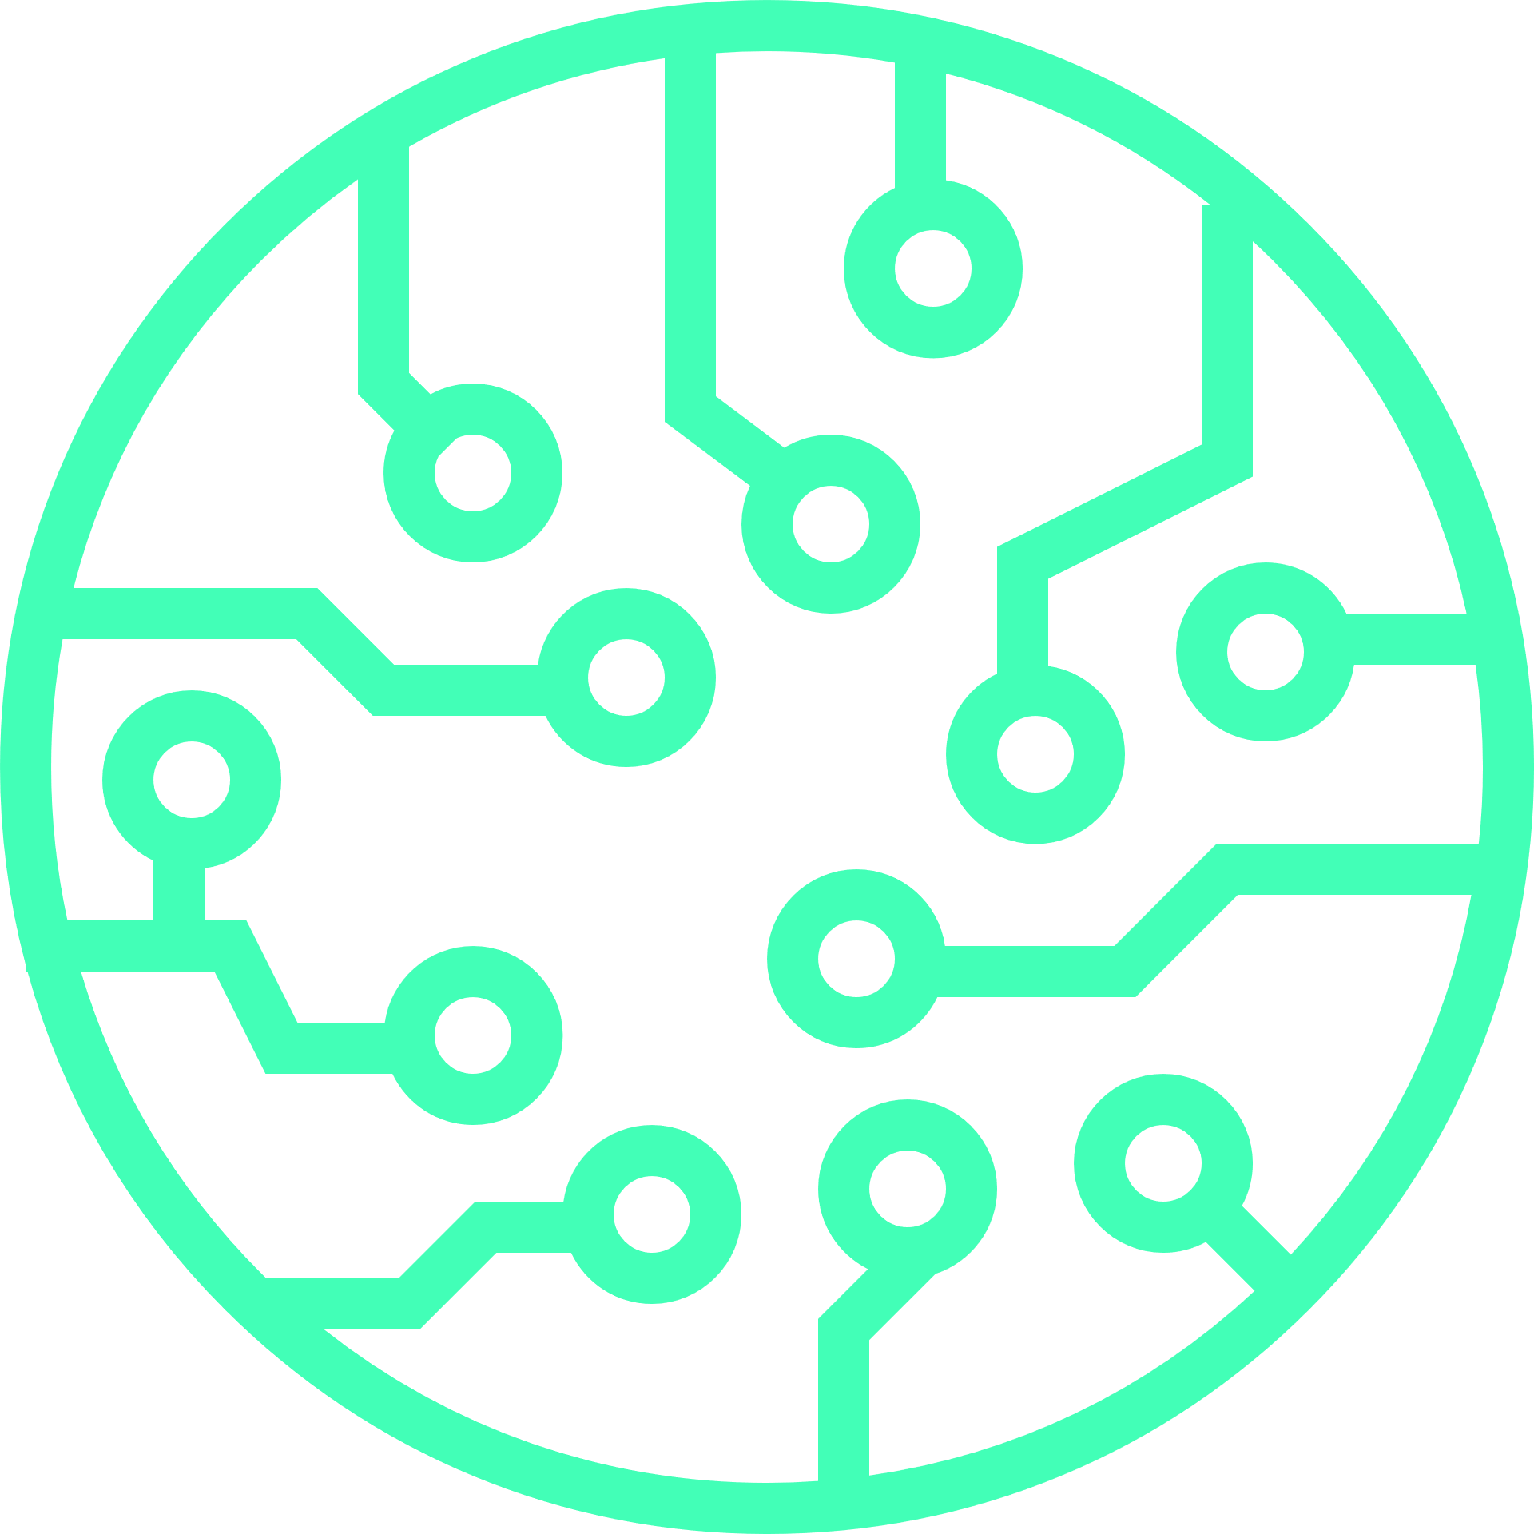



TABLE OF CONTENTS
The Introduction
01
04
Advantage of technology
Information and Communication
Integration of TIC Technologies: A Symbiotic Ecosystem
Extchange Tools
Google Services: A Symphony of Innovation
Gmail: Unleashing Advanced Communication
Google Drive: Navigating the Digital Terrain
Google Workspace: Redefining Collaboration
Future of TIC
02
05
Future Trends in TIC: Navigating the Digital Horizon
Exchange Tools
03
06
The Conclusion
Microsoft Tools: Pioneering Productivity
Git and GitHub: Architecting Code Collaboration
Conclusion: A Tapestry of Innovation

Slide 4
INTRODUCTION

Slide 5




Introduction
In the rapidly evolving landscape of Information and Communication Technologies (ICT), innovation and connectivity intersect, transforming communication and information dynamics. This report explores the profound impact of technology giants like Google and Microsoft, emphasizing their role in reshaping collaboration, data management, and project execution. Additionally, it delves into the paradigm shift in collaborative software development through version control systems like Git and platforms like GitHub.
Technology &
Communcation

Slide 6








Key Components and Framework: ICT
(Information and Communication Technology)
HARDWARE/SOFTWARE
NETWORK
DIGITAL MEDIA
CYBER SECURIT
DATA MANAGEMEN

Slide 7
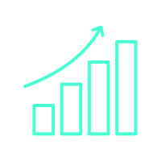
EVOLUTION AND SIGNIFICANCE:
A BRIEF OVERVIEW

Slide 8
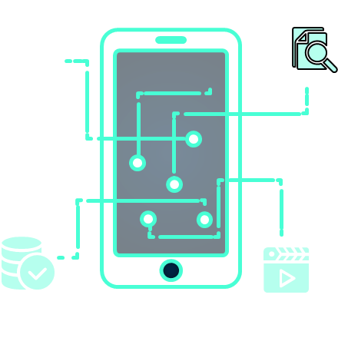
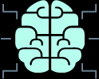
Evolution and Significance: A Brief Overview
Authors like Reix and Rowe (2002) have identified key trends in ICT research, categorizing approaches into technical, behavioral, and sociotechnical. Laudon et al.'s (2006) definition of an organization as a stable social structure guides our exploration. The study of usage sociology emphasizes an activity-oriented paradigm, marking a departure from early system-oriented approaches. The emergence of the Internet, web technologies, and microcomputers propelled the digital era, focusing on direct access to informational resources and the development of communication tools.
Moreover, the literature highlights the dominance of technical and functional discourses in digital technology. A multidimensional approach, recognizing the human aspect, is crucial. ICT involves a division of tasks between systems and human actors, with user involvement and consideration of professional environments being paramount.

Slide 9

GOOGLE SERVICES

Slide 10
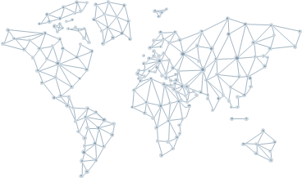

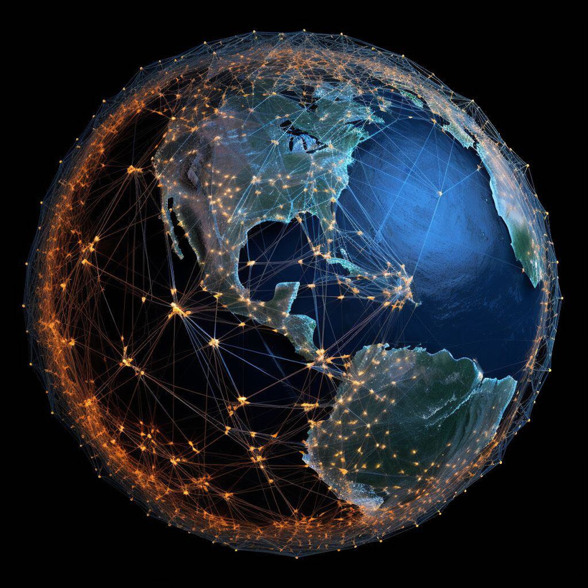

Google Services
Google cloud storage/
It is a cloud storage service provided by Google that allows you to store and retrieve your data securely and reliably. It offers features such as scalability, durability, and global accessibility, making it a great choice for businesses and individuals who need to store and manage large amounts of data.
Google cloud computer engine:
This is a cloud computing service offered by Google that enables you to create and run virtual machines in the cloud. It provides you with the flexibility to choose the type of virtual machine that suits your needs, whether it's a standard instance or a custom instance with specific configurations. With Google Cloud Compute Engine, you can easily scale your computing resources up or down based on demand, making it ideal for businesses that require high-performance computing or need to handle variable workloads.
Google cloud AI platform:
The Google Cloud AI Platform is a comprehensive platform that allows developers and data scientists to build, deploy, and manage machine learning models at scale. It provides a wide range of tools and services for every stage of the machine learning workflow, from data preparation and model training to deployment and prediction. With the Google Cloud AI Platform, you can leverage pre-trained models, use AutoML to build custom models without extensive coding, and take advantage of powerful distributed training capabilities

Slide 11


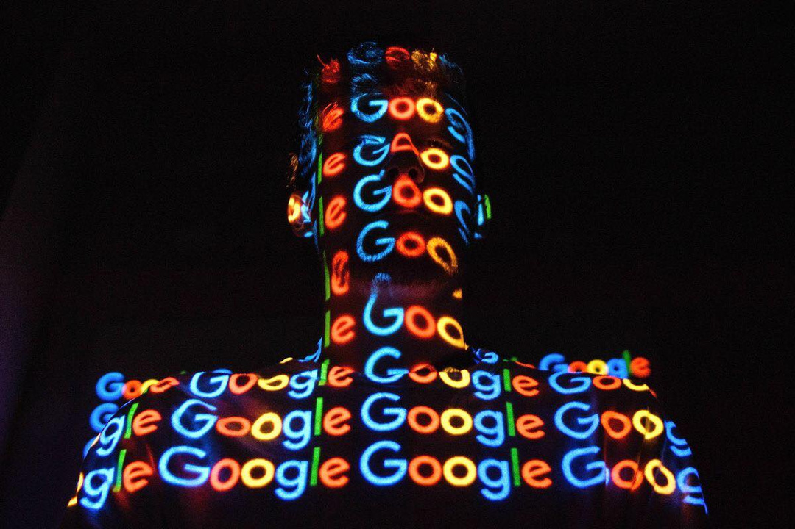
Google Services
Google Workspace Apps:
Formerly known as G Suite, Google Workspace Apps is a collection of productivity tools designed for collaboration and communication. It includes popular applications such as Gmail for email, Google Drive for cloud storage, Google Docs for word processing, Google Sheets for spreadsheets, and Google Slides for presentations. These apps are seamlessly integrated, allowing users to work together in real-time, share documents, and communicate efficiently. Google Workspace Apps is widely used by businesses and individuals to streamline their workflows and enhance productivity.
Google cloud vision API:
The Google Cloud Vision API is a powerful service that enables you to incorporate advanced image recognition and analysis capabilities into
Firebase:
Firebase is a comprehensive mobile and web app development platform that provides a wide range of tools and services to help you build, improve, and grow your app. It offers features such as real-time database, authentication, cloud storage, hosting, and analytics. With Firebase, you can quickly develop high-quality apps, engage and retain users, and easily scale your app as your user base grows. It is a popular choice among developers for its ease of use, robustness, and integration with other Google services.

Slide 12





Google Drive: It's a cloud-based storage platform that offers users a place to store their files securely. With Google Drive, you can upload and store various types of files such as documents, photos, videos, and more. It provides a generous amount of free storage space, and you can also purchase additional storage if needed.
One of the great features of Google Drive is its ability to sync your files across different devices. This means that you can access your files from your computer, smartphone, or tablet, as long as you have an internet connection. It's really convenient because you don't have to worry about transferring files manually between devices.
Google Drive also offers collaboration features, which allow you to share files and folders with others. You can give specific people access to view or edit your files, making it easy to work on projects together. It's a handy tool for team collaborations or sharing files . This means that you can create, editwith friends and family.
Additionally, Google Drive integrates seamlessly with other Google services like Google Docs, Sheets, and Slides, and collaborate on documents directly within Google Drive. It's a fantastic productivity tool for both personal and professional us“

Slide 13

Git and GitHub: Architecting Code Collaboration

Slide 14
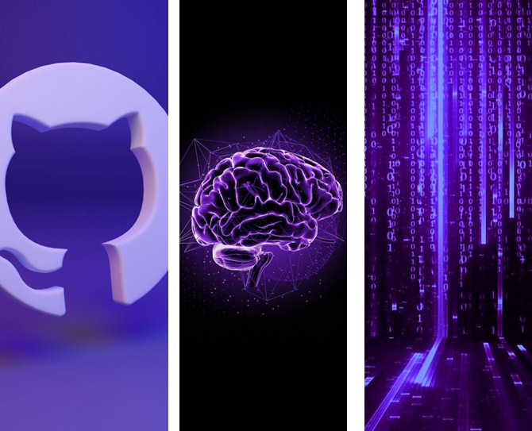
Github
Understanding Git:
Navigating Version Control Branching Strategies: Imagine Git branches as different storylines in a book. Each developer can work on their part without messing up the main plot. This section guides you on the best ways to manage these storylines effectively.
GitHub: The Social Coding Hub:
Picture this as a group project. Pull requests are like presenting your contribution to the team, and code reviews are the team giving feedback. It's the collaborative heart of GitHub where everyone has a say in making the final product better
Conflict Resolution Techniques:
Just like in any team project, conflicts may arise when different people work on the same thing. Git provides strategies to resolve these conflicts peacefully, ensuring your codebase stays harmonious.
GitHub Actions for Automation
GitHub Actions is like having a personal assistant for your coding tasks. It automates routine jobs, like checking your code's spelling or running tests, so you can focus on the creative part of coding.

Slide 15

MICROSOFT TOOLS

Slide 16

Microsoft Teams provides robust features for virtual meetings and collaboration, including high-quality video/audio, interactive tools, and security measures. It enhances productivity through persistent chat channels, real-time co-authoring, task management, and integration with popular apps. The platform promotes increased flexibility, reduced costs, and improved communication within distributed teams. Additionally, Teams serves as a customizable ecosystem, integrating seamlessly with third-party tools and allowing personalized customizations for enhanced efficiency, improved collaboration, increased productivity, and greater flexibility in adapting to specific workflows.

Slide 17
Accessibility tools in Microsoft Office address
For visual impairment, there are screen readers, text-to-speech, and high contrast themes. Mobility limitations are tackled with keyboard shortcuts, dictation, and zoom/magnification. Cognitive accessibility features include language options, focus guides, and the Immersive Reader. General accessibility encompasses alternative text, closed captions, and color scheme customization, ensuring inclusivity for different users.

Slide 18



The Incorporation of TIC on
Project management
Centralized Data Management
Enhanced Communication
Integrating TIC tools enables storage and access to project related data. This reduces the risk of information silos. Ensures that all team members have access to the up
Improves overall
Efficiency
TIC technologies offer communication tools like video conferencing, instant messaging and collaborative platforms
. TIC encompasses a range of tools and systems that streamline communication, data management and project workflows

Slide 19
The Incorporation of TIC on
Project management
Managing Projects
Remotely
Task Automation
TIC technologies enable project managers to efficiently supervise and control projects even when team members are operating from locations. This adaptability proves beneficial in the present day dynamic work setting.
Collaborative Platforms
Incorporating TIC in project management often involves automating tasks reducing effort and minimizing errors. This may include automated updates, notifications or reminders to ensure completion of tasks
TIC technologies often include platforms where team members can work on documents simultaneously share updates and provide real time feedback

Slide 20



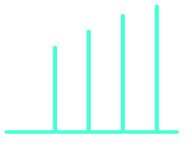























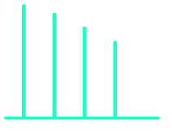












Using TIC tools in Project management:
Advantage 2
Locking It Down: When we bring in TIC, it's like having a security guard for our project data. It keeps the important stuff safe so that only the right people can access it
Advantage 1
Making Sense of Data: TIC tools are like our project detective, helping managers figure out how things are going by looking at the data. It's like finding clues to fix any issues
and make things work better
Advantage 3
Instant Updates: TIC technologies act like our project news reporters, giving us updates right away. This keeps everyone in the loop, helps us stay on top of things, and make quick decisions.

Slide 21

ARTIFICIAL INTELLIGENCE

Slide 22
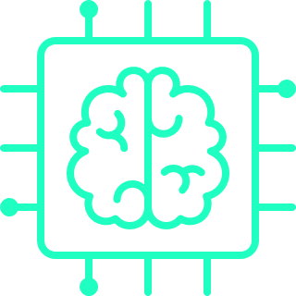
Artificial Intelligence:
A New Landscape or a New Era
AI and cognitive services, once confined to science fiction, are now integral to our everyday reality. AI's role in the Fourth Industrial Revolution stems from the exponential growth of "datafication." The
Shift in AI research from academic-driven to economically and socially motivated is noteworthy. AI's impact on fundamental rights and freedoms, challenges related to opacity, and ethical considerations are essential aspects.

Slide 23
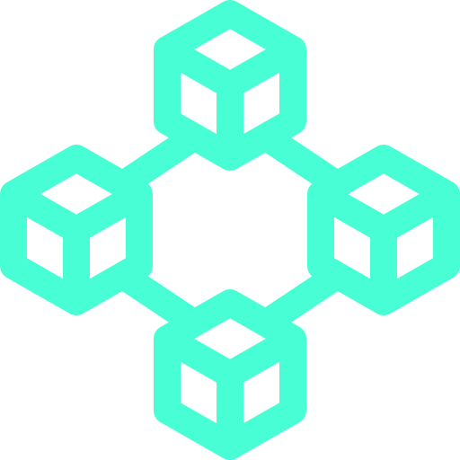
THE BLOCKCHAIN TECHNOLOGY

Slide 24

THE BLOCKCHAIN TECHNOLOGY
Blockchain technology, initially designed for cryptocurrencies, has evolved into a revolutionary force in information security. The report explores the impact of blockchain on security measures, examining key components and applications in secure data storage, identity management, supply chain security, and cybersecurity auditing. Challenges related to scalability, the regulatory landscape, and integration with existing systems are discussed.

Slide 25

AUGMENTED REALITY: TRANSFORMING USER EXPERIENCE

Slide 26
Augmented Reality:
Transforming User Experience
Augmented Reality (AR) seamlessly integrates digital information into the real world, revolutionizing user experiences. The report covers the key components of AR, including sensors, display technology, and computer vision. Applications range from enhancing the retail experience and immersive gaming to education, training, and healthcare assistance. Challenges related to hardware limitations, content creation, and privacy concerns are highlighted.

Slide 27

CONCLUSION

Slide 28
Technology is about how we connect and collaborate.
Technology determines the Future.
<
Lets build a futur where technology is a tool for connection collaboration and positive development
/>

Slide 29
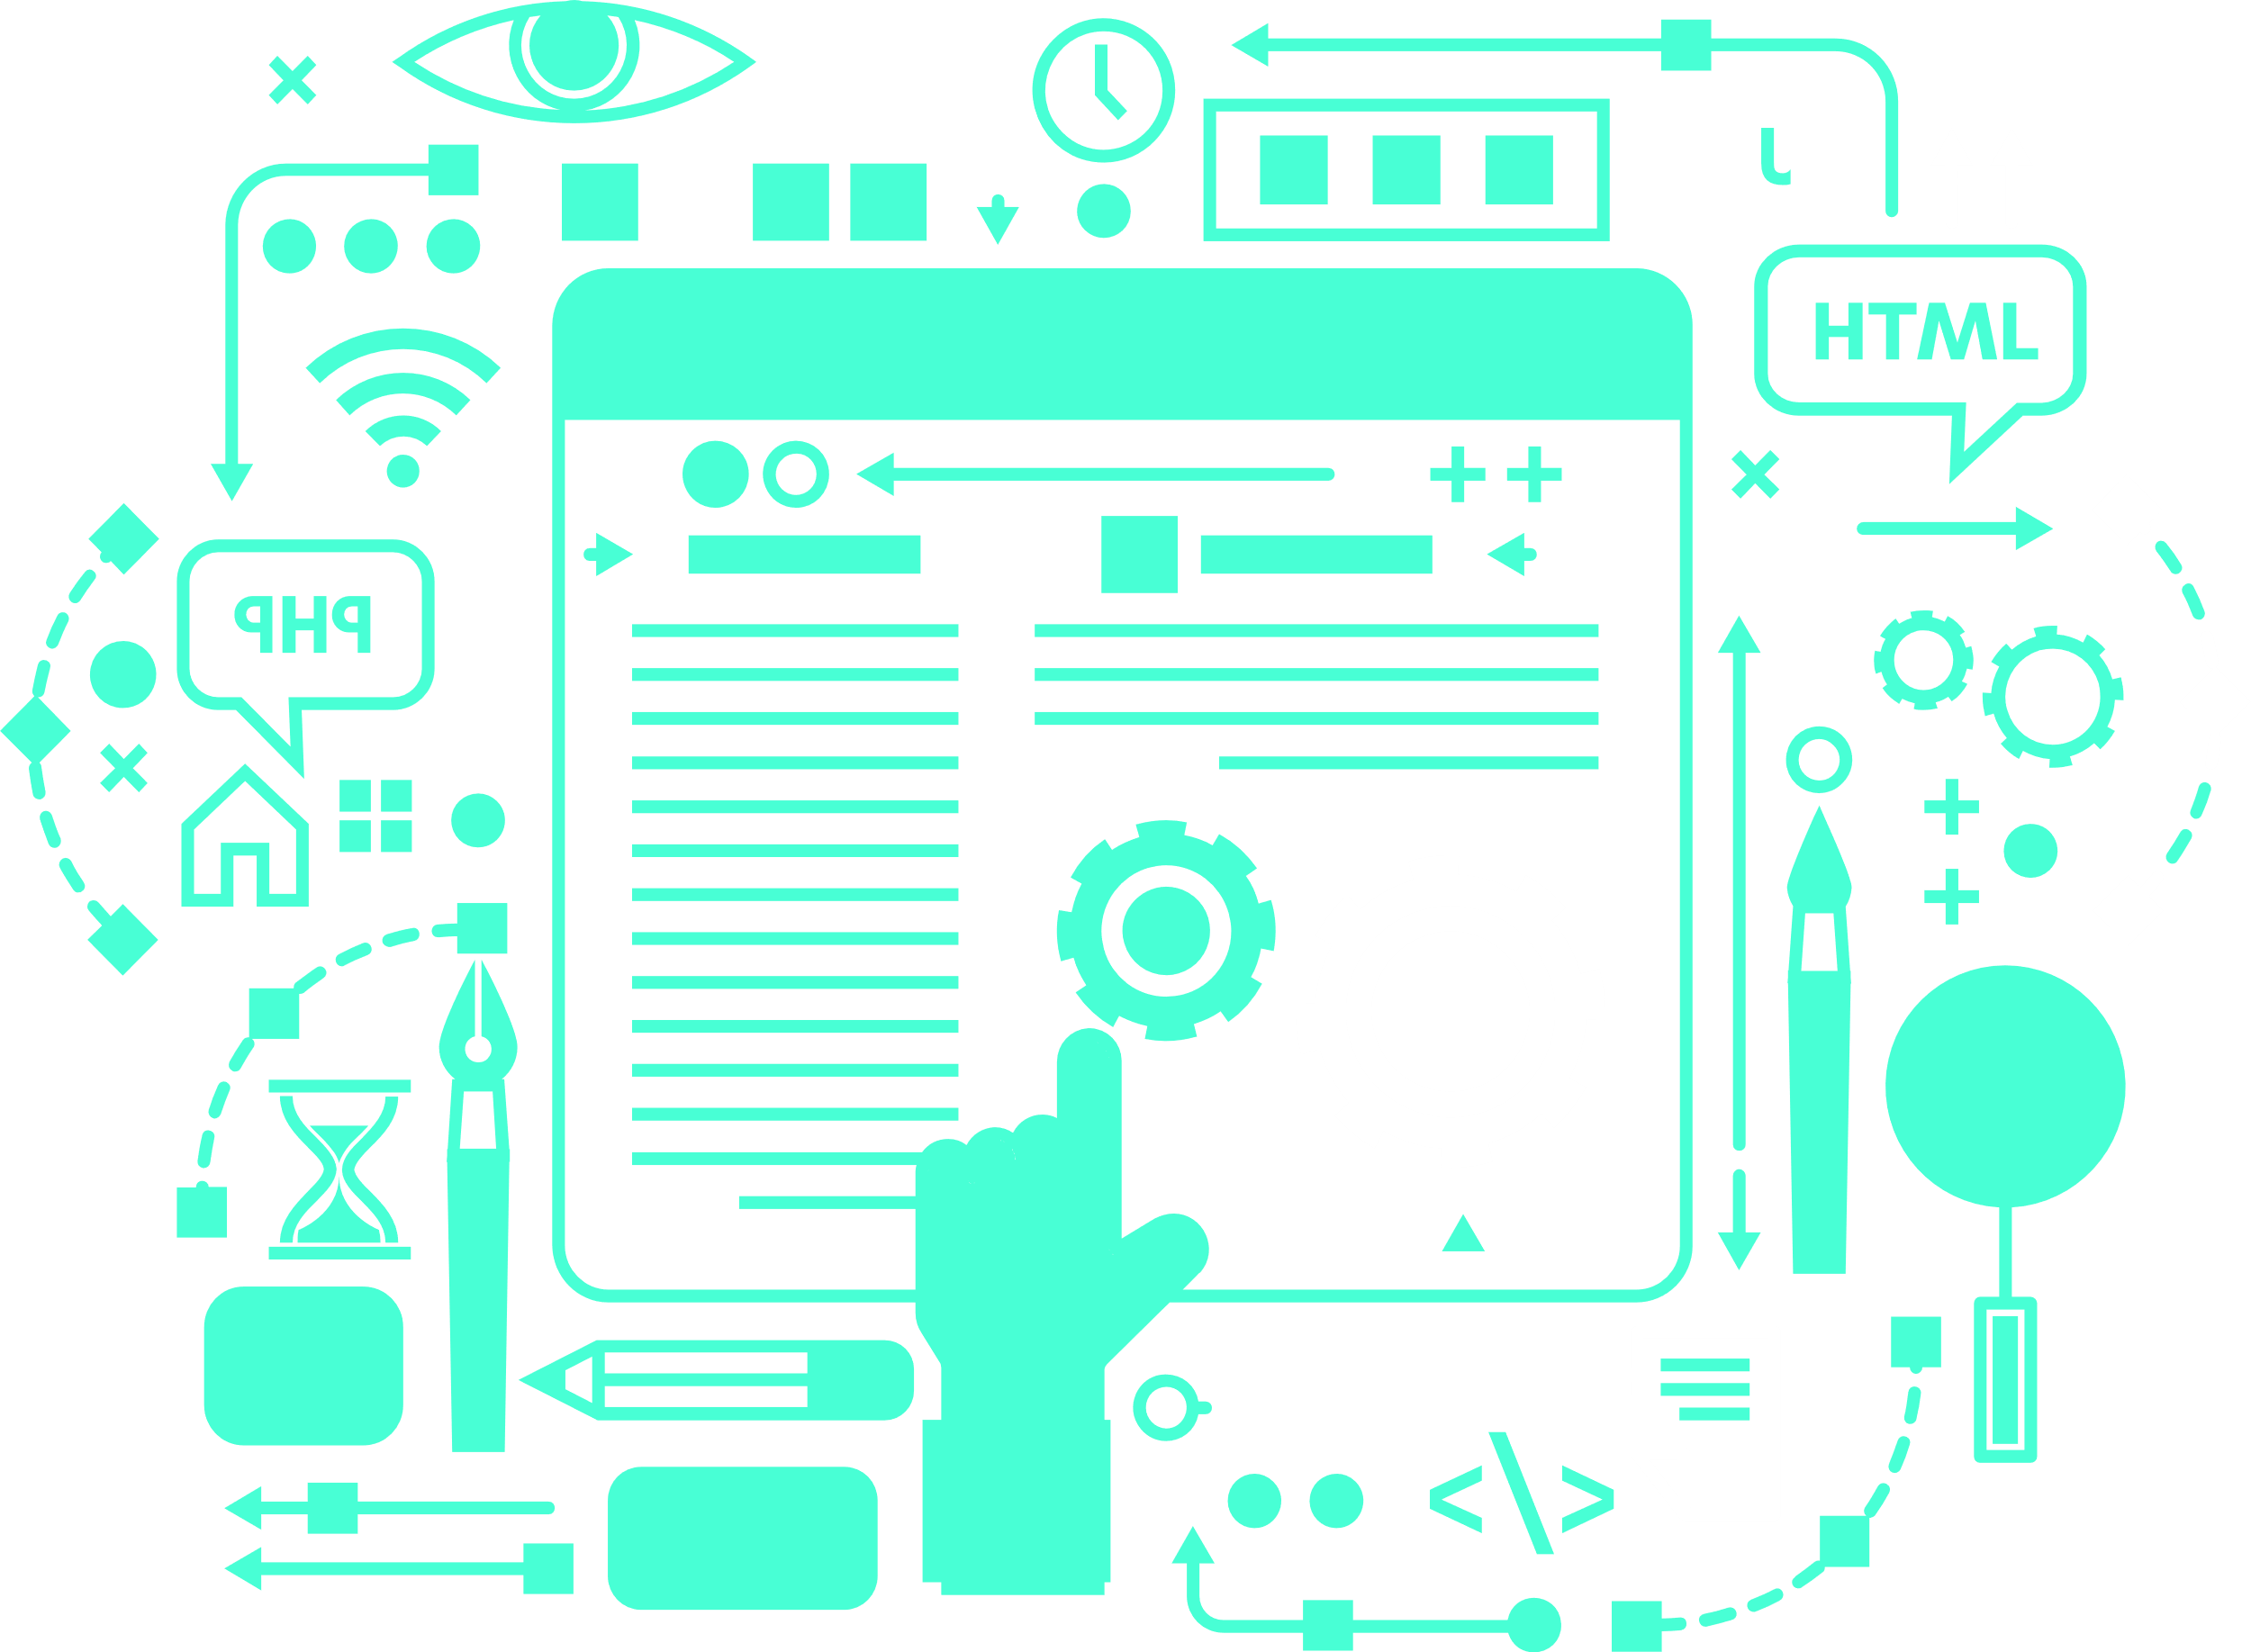
THANK YOU FOR YOUR ATTENTION

